Slide 1

Sign language detection
Szabó, Marcell (255131)
Barnard, Francois (252338)
Steevensz, Duko (251786)
30-1-2026

Slide 2
Table of contents
01
02
03
04
05
The Problem
Solution
Data
06
Results
New Addition
Conclusion

Slide 3

01
The Problem
30.000 people rely on NGT
Shortage of resources

Slide 4
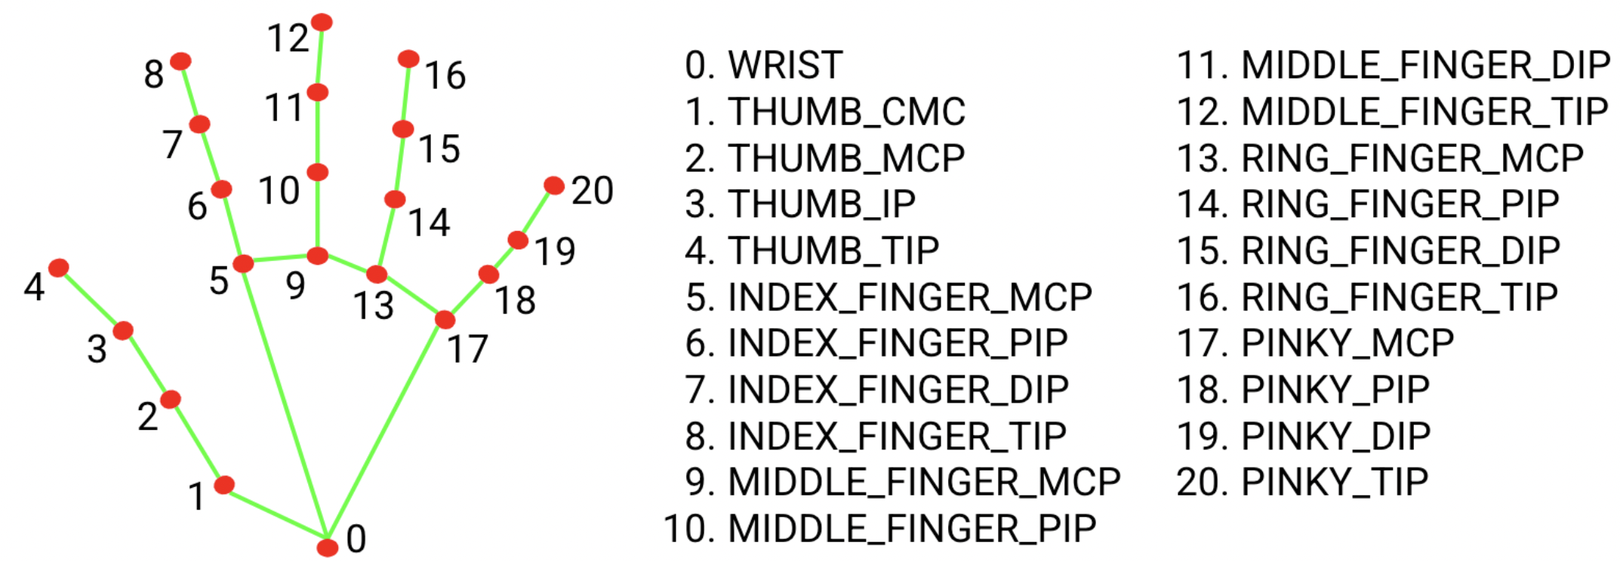
02
Solution
Mediapipe
Hand landmarks
Instant feedback

Slide 5
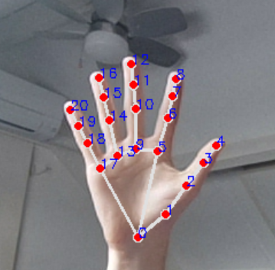
03
Data
No initial data set
Collecting data
x,y,z
Final shape: (2848, 64)
RandomForestClassifier

Slide 6
04
Results
Accuracy: 0.963 (96.3%)
Classification Report:
precision recall f1-score support
A 0.93 0.94 0.93 67
B 0.98 0.98 0.98 61
C 0.97 0.91 0.94 35
D 0.94 0.94 0.94 18
E 0.91 0.96 0.94 54
F 1.00 1.00 1.00 42
G 0.94 0.94 0.94 16
H 0.93 1.00 0.96 13
I 1.00 1.00 1.00 13
J 0.94 1.00 0.97 16
K 1.00 1.00 1.00 22
L 1.00 1.00 1.00 12
M 0.94 1.00 0.97 16
N 1.00 0.95 0.97 19
O 0.98 0.98 0.98 47
P 1.00 0.95 0.97 19
Q 0.95 1.00 0.97 19
R 1.00 1.00 1.00 27
S 0.88 0.81 0.84 26
T 0.92 1.00 0.96 22
U 1.00 1.00 1.00 26
V 1.00 1.00 1.00 17
W 1.00 0.97 0.98 32
X 1.00 1.00 1.00 26
Y 1.00 0.88 0.94 26
Z 0.90 0.90 0.90 21
accuracy 0.96 712
macro avg 0.97 0.97 0.97 712
weighted avg 0.96 0.96 0.96 712
User friendly
Instant feedback
limitations

Slide 7
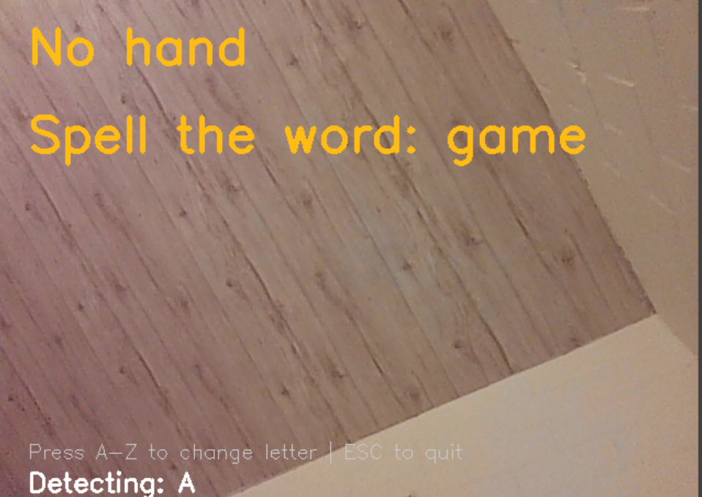
05
New Addition
Word Spelling
Instant feedback
limitations

Slide 8
06
Conclusion
Positive
Questions?

